Slide 1
PRE – REREQUISITE FOR THE COURES
Computer
Software / Computer N/W
IP address
File management system / DBMS
Server / Client server architecture
Protocol / Router /Port
HTTP / HTTPS / SSL / DNS / ISP
Localhost / JDK /JRE
URL / URI / GUI
S/W environment
Virtualization
cloud

Slide 2
Computer
It’s a combination of hardware & software
Which works under the set of instruction given by the software
It’s also used to storing & processing data

Slide 3
Software
It’s a collection of programs & operating information used by a computer.
Which gives the set of instruction to the hardware & user.
2 types of s/w :- 1) System s/w – Linux , windows.
2) Application s/w – ppt , note pad.
OR
Software is a collection of instructions that tell a computer how to work. This is in contrast to hardware, from which the system is built and which actually performs the work.

Slide 4
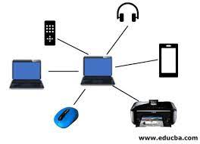
Computer N/W
A network is a collection of computers, servers, mainframes, network devices, peripherals, or other devices connected to allow data sharing.
An example of a network is the Internet, which connects millions of people all over the world.

Slide 5
IP address
An IP address is a string of numbers separated by periods.
IP addresses are expressed as a set of four numbers
example:- address might be 192.158. 1.38.
Each number in the set can range from 0 to 255.
Types of Ip address :- ipv4 & ipv6
IPV4 :- internet Protocol version 4 with 32 bit address
IPV6 :- internet Protocol version 6 with 128 bit address

Slide 6
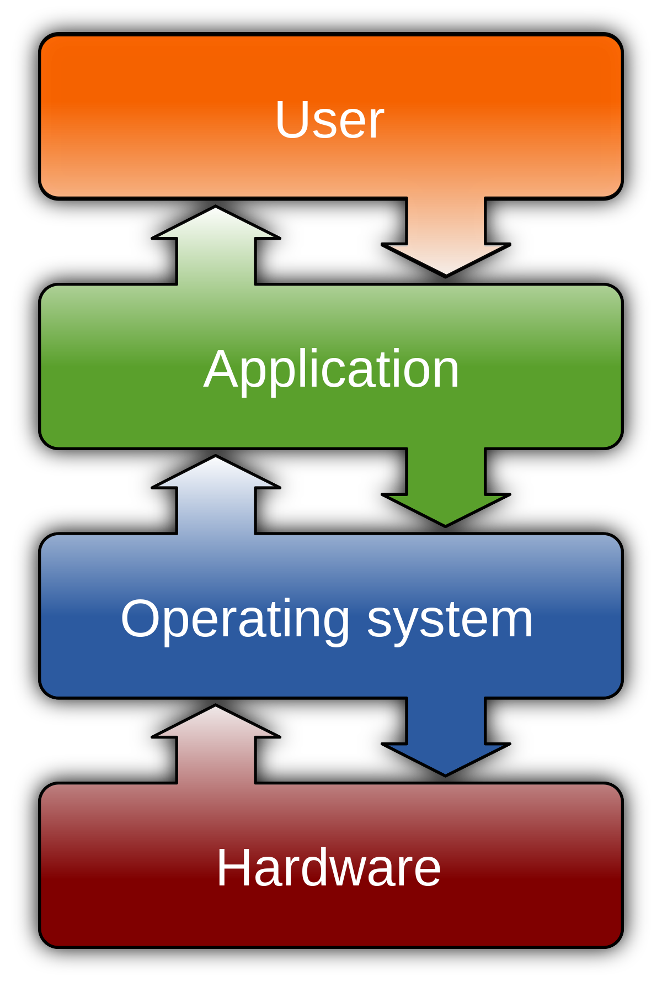
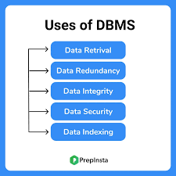
File management system / DBMS
A file management system is used for file maintenance (or management) operations. It is a type of software that manages data files in a computer system.
A file management system has limited capabilities and is designed to manage individual or group files, such as special office documents and records.
Database Management Systems (DBMS) are software systems used to store, retrieve, and run queries on data.
A DBMS serves as an interface between an end-user and a database, allowing users to create, read, update, and delete data in the database.
Types :- Relational DBMS – independent table
N/W DBMS – graphical representation
Hierarchical DBMS – tree like structure

Slide 7
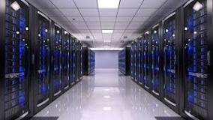
Server
A server is a computer program or device that provides a service to another computer program and its user, also known as the client.
In a data centre, the physical computer that a server program runs on is also frequently referred to as a server
OR
It’s a machine which will have the capability to accept the request & respond to the request

Slide 8
Client server architecture
Client-server model is a distributed application structure that partitions tasks or workloads between the providers of a resource or service, called servers, and service requesters, called clients.
Types :-
2 TIER - Is similar to a basic client-server model. The application at the client end directly communicates with the database at the server-side.
3 TIER - there is another layer between the client and the server. The client does not directly communicate with the server. Instead, it interacts with an application server which further communicates with the database system and then the query processing and transaction management takes place. This intermediate layer acts as a medium for the exchange of partially processed data between server and client. This type of architecture is used in the case of large web applications.
n TIER - n-tier architecture models that have more than three tiers. Examples are applications that have these tiers: Services – such as print, directory, or database services. It is suitable to support enterprise level client-server applications by providing solutions to scalability, security, fault tolerance, reusability, and maintainability. It helps developers to create flexible and reusable applications.

Slide 9
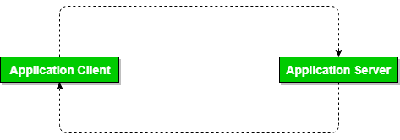
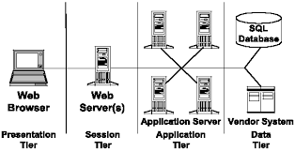
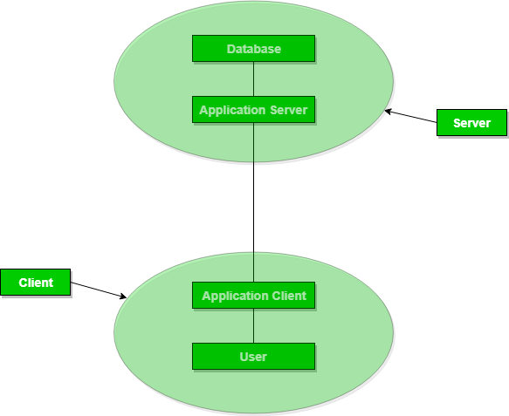
2 - TIER / 3 - TIER / n - TIER

Slide 10
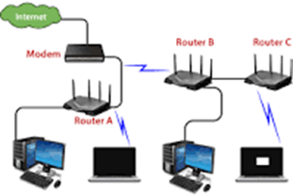


Protocol / Router /Port
PROTOCOL :- it’s a set of rules for transmitting data between computers.
In order for computers to exchange information, there must be a pre-existing agreement as to how the information will be structured and how each side will send and receive it.
ROUTER :- is a networking device that forwards data packets between computer networks.
Routers perform the traffic directing functions on the Internet.
Data sent through the internet, such as a web page or email, is in the form of data packets.
PORTS :-are virtual places within an operating system where network connections start and end.
They help computers sort the network traffic they receive.
In computer networking, a port is a communication endpoint. At the software level, within an operating system, a port is a logical construct that identifies a specific process or a type of network service.

Slide 11
HTTP / HTTPS / SSL / DNS / ISP
Hypertext Transfer Protocol (HTTP) is an application-layer protocol for transmitting hypermedia documents, such as HTML. It was designed for communication between web browsers and web servers, but it can also be used for other purposes.
Hypertext Transfer Protocol Secure (HTTPS) is an extension of the Hypertext Transfer Protocol. It is used for secure communication over a computer network, and is widely used on the Internet. In HTTPS, the communication protocol is encrypted using Transport Layer Security or, formerly, Secure Sockets Layer.
Secure Sockets Layer (SSL) uses port number 443, encrypting data exchanged between the browser and the server and authenticating the user. Therefore, when the communications between the web browser and server need to be secure, the browser automatically switches to SSL — that is, as long as the server has an SSL certificate installed.
The Domain Name System (DNS) turns domain names into IP addresses, which browsers use to load internet pages. Every device connected to the internet has its own IP address, which is used by other devices to locate the device.
Internet service provider (ISP) company that provides Internet connections and services to individuals and organizations. In addition to providing access to the Internet, ISPs may also provide software packages (such as browsers), e-mail accounts, and a personal Web site or home page.

Slide 12
Localhost / JDK /JRE
LOCALHOST :- is a hostname that refers to the current device used to access it. It is used to access the network services that are running on the host via the loopback network interface. Using the loopback interface bypasses any local network interface hardware.
Java Development Kit (JDK) :- is a distribution of Java Technology by Oracle Corporation. It implements the Java Language Specification and the Java Virtual Machine Specification and provides the Standard Edition of the Java Application Programming Interface.
Java Runtime Environment (JRE) :-The JRE allows some applications written in the Java programming language to launch via some browsers. The Java Plug-in software is not a standalone program and cannot be installed separately.

Slide 13
URL / URI / GUI
URL — Uniform Resource Locator
It’s an acronym for Uniform Resource Locator and is a reference (an address) to a resource on the Internet.
A URL has two main components: Protocol identifier: For the URL http://example.com , the protocol identifier is http .
Resource name: For the URL http://example.com , the resource name is example.com
URI — Uniform Resource Identifier
It’s a sequence of characters that distinguishes one resource from another.
For example, foo://example.com:8042/over/there?name=ferret#nose is a URI containing a scheme name, authority, path, query and fragment.
GUI — Graphical User Interface
It’s a form of user interface that allows users to interact with electronic devices through graphical icons and audio indicator such as primary notation, instead of text-based user interfaces, typed command labels or text navigation.

Slide 14
S/W environment
Software environment is the term commonly used to refer to support an application. A software environment for a particular application could include the operating system, the database system, specific development tools or compiler.
Development Environment: This is where application/system development tasks, such as designing, programming, debugging, etc., take place.
Test Environment: As the name implies, this is where application testing is conducted to find and fix errors.
Staging Environment: Here, all the work done in the development environment is merged into the built system (often used to automate the process of software compilation) before it is moved into the production environment.
Production Environment: The last environment in software development, this is where new builds/updates are moved into production for end users.
Ex:- Different Types of Testing Environments
Performance Testing Environment / System Integration Testing (SIT) / User Acceptance Testing (UAT) .
Quality Assurance (QA).
Security Testing.
Chaos Testing.
Alpha Testing.
Beta Testing.

Slide 15
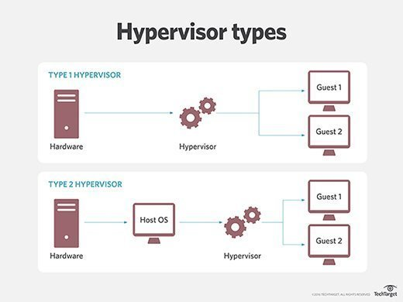
Virtualization
Virtualization relies on software to simulate hardware functionality and create a virtual computer system. This enables IT organizations to run more than one virtual system – and multiple operating systems and applications – on a single server. The resulting benefits include economies of scale and greater efficiency
OR
Virtualization is technology that lets you create useful IT services using resources that are traditionally bound to hardware. It allows you to use a physical machine's full capacity by distributing its capabilities among many users or environments.
Type of virtualization :- Type 1 & Type 2
Type 1 hypervisors is that runs on bare metal
Type 2 runs on top of an operating system.
Each hypervisor type also has its own pros and cons and specific use cases

Slide 16
Cloud
Cloud computing is the on-demand availability of computer system resources, especially data storage and computing power, without direct active management by the user. Large clouds often have functions distributed over multiple locations, each location being a data center.
Cloud Service Models Cloud Deployment Models
3 types of cloud service models - 4 types of cloud deployment models -
Infrastructure as a Service (IaaS) 1. Private cloud
Platform as a Service (PaaS) 2. Public cloud
Software as a Service (SaaS) 3. Hybrid cloud
4. community could

Slide 17
Infrastructure as a Service (IaaS)
IaaS is also known as Hardware as a Service (HaaS). It is a computing infrastructure managed over the internet. The main advantage of using IaaS is that it helps users to avoid the cost and complexity of purchasing and managing the physical servers.
Characteristics of IaaS
Resources are available as a service.
Services are highly scalable.
Dynamic and flexible.
GUI and API-based access.
Automated administrative tasks.
Example: DigitalOcean, Linode, Amazon Web Services (AWS), Microsoft Azure, Google Compute Engine (GCE), Rackspace, and Cisco Metacloud.

Slide 18
Platform as a Service (PaaS)
PaaS cloud computing platform is created for the programmer to develop, test, run, and manage the applications.
Characteristics of PaaS
Accessible to various users via the same development application.
Integrates with web services and databases.
Builds on virtualization technology, so resources can easily be scaled up or down as per the organization's need.
Support multiple languages and frameworks.
Provides an ability to "Auto-scale".
Example: AWS Elastic Beanstalk, Windows Azure, Heroku, Force.com, Google App Engine, Apache Stratos, Magento Commerce Cloud, and OpenShift.

Slide 19
Software as a Service (SaaS)
SaaS is also known as "on-demand software". It is a software in which the applications are hosted by a cloud service provider. Users can access these applications with the help of internet connection and web browser.
Characteristics of SaaS
Managed from a central location.
Hosted on a remote server.
Accessible over the internet.
Users are not responsible for hardware and software updates. Updates are applied automatically.
The services are purchased on the pay-as-per-use basis.
Example: BigCommerce, Google Apps, Salesforce, Dropbox, ZenDesk, Cisco WebEx, ZenDesk, Slack, and GoToMeeting.

Slide 20
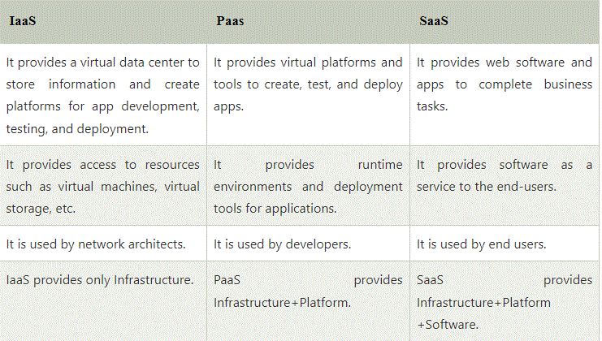
Difference between IaaS, PaaS, and SaaS

Slide 21
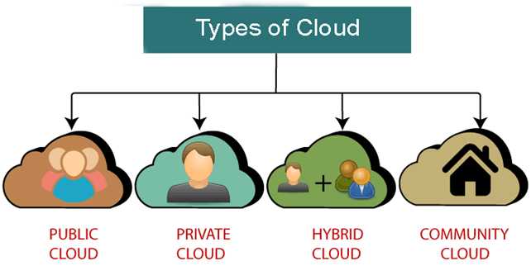
Cloud Deployment Models

Slide 22
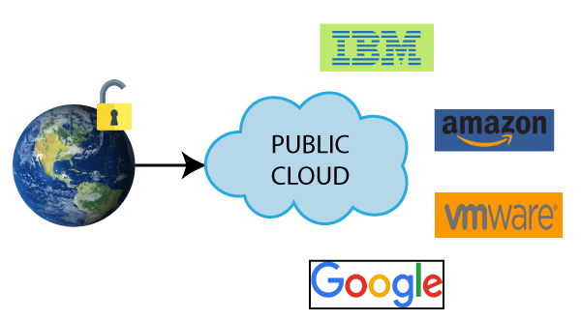
Public Cloud
Public cloud is open to all to store and access information via the Internet using the pay-per-usage method.
In public cloud, computing resources are managed and operated by the Cloud Service Provider (CSP).
Example: Amazon elastic compute cloud (EC2), IBM Smart Cloud Enterprise, Microsoft, Google App Engine, Windows Azure Services Platform.

Slide 23
Advantages & Disadvantages of Public cloud
Advantages of Public Cloud
Public cloud is owned at a lower cost than the private and hybrid cloud.
Public cloud is maintained by the cloud service provider, so do not need to worry about the maintenance.
Public cloud is easier to integrate. Hence it offers a better flexibility approach to consumers.
Public cloud is location independent because its services are delivered through the internet.
Public cloud is highly scalable as per the requirement of computing resources.
It is accessible by the general public, so there is no limit to the number of users.
Disadvantages of Public Cloud
Public Cloud is less secure because resources are shared publicly.
Performance depends upon the high-speed internet network link to the cloud provider.
The Client has no control of data.

Slide 24
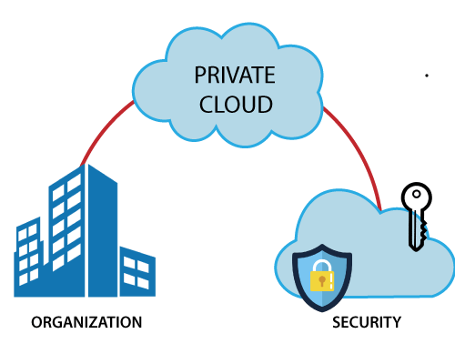
Private Cloud
Private cloud is also known as an internal cloud or corporate cloud.
It is used by organizations to build and manage their own data centres internally or by the third party. It can be deployed using Opensource tools such as Open stack and Eucalyptus.
Based on the location and management, National Institute of Standards and Technology
(NIST) divide private cloud into the following two parts-
On-premise private cloud
Outsourced private cloud

Slide 25
Advantages & Disadvantages of Private Cloud
Advantages of Private Cloud
Private cloud provides a high level of security and privacy to the users.
Private cloud offers better performance with improved speed and space capacity.
It allows the IT team to quickly allocate and deliver on-demand IT resources.
The organization has full control over the cloud because it is managed by the organization itself. So, there is no need for the organization to depends on anybody.
It is suitable for organizations that require a separate cloud for their personal use and data security is the first priority.
Disadvantages of Private Cloud
Skilled people are required to manage and operate cloud services.
Private cloud is accessible within the organization, so the area of operations is limited.
Private cloud is not suitable for organizations that have a high user base, and organizations that do not have the prebuilt infrastructure, sufficient manpower to maintain and manage the cloud.

Slide 26
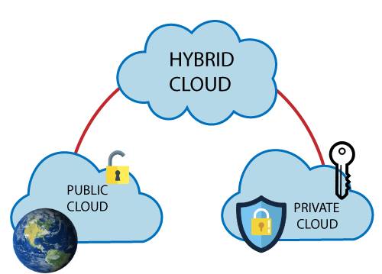
Hybrid Cloud
Hybrid Cloud is a combination of the public cloud and the private cloud. we can say:
Hybrid Cloud = Public Cloud + Private Cloud
Hybrid cloud is partially secure because the services which are running on the public cloud can be accessed by anyone, while the services which are running on a private cloud can be accessed only by the organization's users.
Example: Google Application Suite (Gmail, Google Apps, and Google Drive), Office 365 (MS Office on the Web and One Drive), Amazon Web Services.

Slide 27
Advantages & Disadvantages of Hybrid Cloud
Advantages of Hybrid Cloud
Hybrid cloud is suitable for organizations that require more security than the public cloud.
Hybrid cloud helps you to deliver new products and services more quickly.
Hybrid cloud provides an excellent way to reduce the risk.
Hybrid cloud offers flexible resources because of the public cloud and secure resources because of the private cloud.
Disadvantages of Hybrid Cloud
In Hybrid Cloud, security feature is not as good as the private cloud.
Managing a hybrid cloud is complex because it is difficult to manage more than one type of deployment model.
In the hybrid cloud, the reliability of the services depends on cloud service providers.

Slide 28
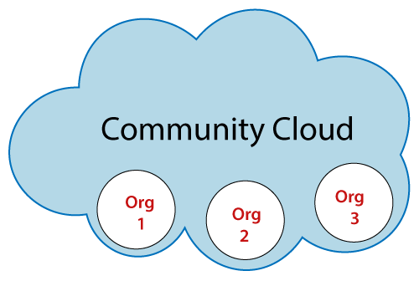
Community Cloud
Community cloud allows systems and services to be accessible by a group of several organizations to share the information between the organization and a specific community.
It is owned, managed, and operated by one or more organizations in the community, a third party, or a combination of them.
Example: Health Care community cloud

Slide 29
Advantages & Disadvantages of Community Cloud
Advantages of Community Cloud
Community cloud is cost-effective because the whole cloud is being shared by several organizations or communities.
Community cloud is suitable for organizations that want to have a collaborative cloud with more security features than the public cloud.
It provides better security than the public cloud.
It provdes collaborative and distributive environment.
Community cloud allows us to share cloud resources, infrastructure, and other capabilities among various organizations.
Disadvantages of Community Cloud
Community cloud is not a good choice for every organization.
Security features are not as good as the private cloud.
It is not suitable if there is no collaboration.
The fixed amount of data storage and bandwidth is shared among all community members.

Slide 30
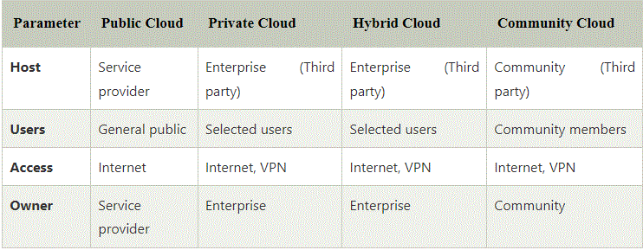
Difference between public cloud, private cloud, hybrid cloud, and community cloud -

